Slide 1
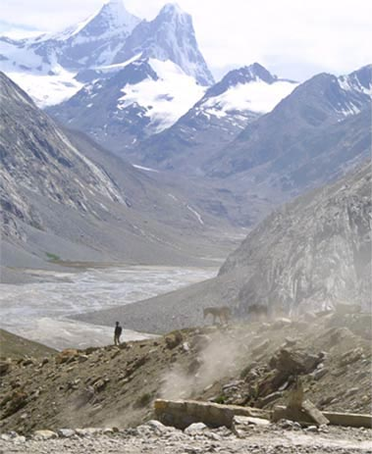
Fellowship of the Heart
Getting Started — the Four Connects, walked around the table on alternating evenings
Evening Series 2026–27 · at the Tittle home · v1.5E DRAFT
All Scripture: ESV · The Companion lesson plans carry the full scripts — these slides carry the room
1
Notes:
DECK TITLE · pre-session · DIVIDER
On screen as the room assembles on night one. All Scripture ESV; the plans carry the scripts; these slides carry the room — and these notes carry you.

Slide 2

SESSION 19
Second Running: Block B
The rehearsal — the Companions-in-Formation teach the two mercy cards in the small room, one week before they teach them in the large
Quarter 4: Consolidation & Sending
231
Notes:
S19 · pre-session · DIVIDER
On screen through dinner and as the circle forms. Greet at the door — the slide holds the room. Folders at each seat with both mercy cards in them; the CiFs set their first pair spaces; tissues in every pair space. Doors close at 7:00.

Slide 3
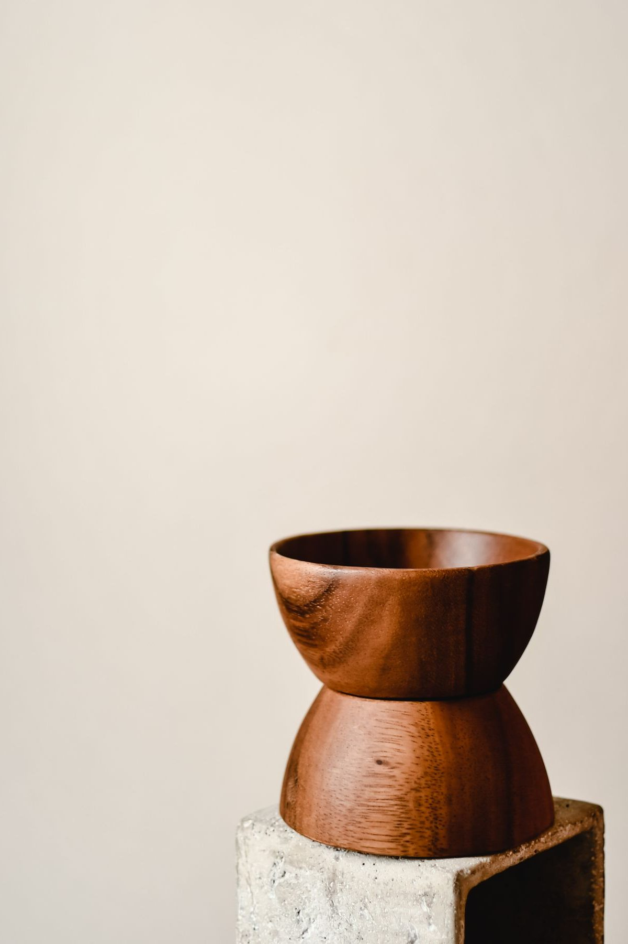
Session 19 — Tonight’s Road
1 Welcome and opening container
2 The frame — why these two cards
3 Bridge and split
4 First teaching rep — both cards
5 pair feedback — one keep, one adjust
6 Second teaching rep — both cards, tightened
7 Second pair feedback
8 Merge and between-session
9 Closing container
10 Leader Feedback Round
11 Aaronic blessing and sending
232
Notes:
S19 · 7:00–8:30 · LEAD: BOTH LEADERS CIRCLE
BEATS:
1. Today is the rehearsal: the Companions-in-Formation teach the Signs Card and the Path Home Card in pairs — twice each, coached — one week before they teach the whole room.
2. Shape: frame, split, first rep, keep-and-adjust feedback, rotation, tightened second rep, second feedback, merge, close.
3. Adults coach from inside the pair, light touch — at most one whispered cue per rep; the rehearsal is the CiF's room.
GUARD: Teach the card, never probe the person — 'take out the card,' never 'which column are you in.' Any live disclosure passes to the pair adult at once, and the handoff is honored publicly as leadership, not failure.

Slide 4
Opening Container — the Eight Steps
1 Welcome — five minutes to open the container
2 Phones silenced and put away
3 Stand in a circle
4 One-word check-in — how you actually are, right now
5 Put out / bring in — set something down; bring a blessing in
6 Spoken commitment: “I am here. I am paying attention. I am willing to be moved.”
7 Opening prayer — “Holy Spirit, you are welcome here. Speak. We are listening.”
8 Sit. Begin.
233
Notes:
S19 · 7:00–7:08 · LEAD: CONTAINER HOLDER CIRCLE
BEATS:
1. A Companion-in-Formation opens with the full protocol from memory — the weekly free rep.
2. The open goes to a CiF who is NOT teaching first-round in their strongest pair, so the session's reps spread rather than stack.
3. Receive every check-in word; read the room — today's subject is dryness, and somebody is statistically in it right now.

Slide 5
The Frame — Why These Two Cards
• Sooner or later, everyone who walks with God hits a dry season — and the dangerous thing is not the dryness, it is the wrong diagnosis
• The Signs Card — so a misread dry season never ends a journey in this room
• The Path Home Card — the written door back, and it ends the way Luke 15 ends: the father runs
• Tonight is a rehearsal — the small room before the large one. Your pair is their first congregation.
• At the end, your pair gives its teacher two gifts: one thing to keep, and one thing to adjust
• Tonight is about the cards, not anyone’s current season — nobody will be asked where they are
2 TIMOTHY 2:2
“and what you have heard from me in the presence of many witnesses entrust to faithful men, who will be able to teach others also.”
Four generations in one sentence — Paul, Timothy, the faithful, and the others also. Tonight you are watching the third handoff happen.
234
Notes:
S19 · 7:25–7:31 · LEAD: CONTENT PRESENTER CIRCLE
BEATS:
1. Everyone takes out both cards. Why they exist: the danger of a dry season is the wrong diagnosis, and the way back must be written down — the father runs.
2. Read 2 Timothy 2:2 — four generations in one sentence; today the room watches the third handoff happen.
3. Name the rehearsal plainly and warmly: small room before the large one; your pair is their first congregation, and at the end it gives its teacher two gifts — one keep, one adjust.
4. End gently: today is about the cards, not anyone's current season — but if a column has your name on it, the adult in your pair is there for exactly that.
GUARD: Say from the front that nobody will be asked where they are — it keeps the promise true in the pairs.

Slide 6
Bridge and Split
• Each pair named — its families, its adult, its first-round Companion-in-Formation
• Pray — for the teachers by name, and for any dry ground in the room, unnamed
• Then split — receive your teacher, and work the cards with them
235
Notes:
S19 · 7:31–7:32 · LEAD: CONTENT PRESENTER CIRCLE
BEATS:
1. Name each pair: its families, its adult coach-and-catch, its first-round teacher.
2. Pray briefly — for the teachers by name, and for any dry ground in the room, unnamed.
3. Split fast — the teaching minutes are protected.
CUES: About ten or fewer in the room? Small-room variation: one circle, two CiFs split the cards, feedback after each, then a compressed second pass with the cards swapped — everyone still teaches twice.

Slide 7
First Teaching Rep — Both Cards
1 The Signs Card (~13 min) — the one question: “Which way does the desire point?” Then the four kinds of dry, from the card’s own table
– Cases 3 and 4 — one says resist, the other says receive; opposite motions. When you cannot tell which you are in, do not decide alone.
2 The Path Home Card (~10 min) — the five steps, and the reception: it ends with a feast, not a hearing
– “The door is not locked. The light is on.”
3 Close (~2 min) — both cards go home tonight; this week your family gives them a findable spot
• Questions of information are welcome — the teacher answers them. The adults hold every door that opens.
LUKE 15:20
“while he was still a long way off, his father saw him and felt compassion, and ran”
236
Notes:
S19 · 7:32–7:52 · LEAD: CONTENT PRESENTER · FAMILY PAIRS
BEATS:
1. The CiF teaches both cards: Signs ~13 min — the sorting question (which way does the desire point?), the four kinds of dry, cases 3 and 4 command OPPOSITE motions (resist vs receive; when unsure, do not decide alone), the four rules; Path Home ~10 — five steps, the father runs, the door is not locked; close ~2 — the findable spot.
2. Adult sits inside the circle, coaching light — one whispered cue at most ('desire question' is usually the only one needed); everything else to the note sheet.
CUES: Teen-taught block — the adult sits where the teacher can find their eyes. If anything live surfaces the adult receives it at once while the CiF keeps teaching; a stumble is never the story of the night.
GUARD: Redirect probing and diagnosing gently and immediately — quote the card's own rule so the correction lands on the card, not the person.

Slide 8
pair Feedback — One Keep, One Adjust
• The adult models first — one specific keep, one specific adjust
– Specific means quotable: “keep the way you paused after the desire question” — not “you did great”
• Then a parent adds one; one or two more voices if brief — teens welcome
• The teacher receives without defending — “thank you” is the whole response
• Both gifts go on the note sheet — this block is the reason the evening exists
237
Notes:
S19 · 7:52–7:57 · LEAD: CONTENT PRESENTER · FAMILY PAIRS
BEATS:
1. The adult models first — one specific keep, one specific adjust; quotable, never 'you did great.'
2. The arranged parent adds next (Run Card); one or two brief voices more, teens welcome.
3. The CiF receives without defending — 'thank you' is the whole response; the adult writes both gifts down.
4. Rotation at 4:56: 'Teachers, travel' — each CiF one pair clockwise, adjust in hand; the new pair does not hear the old feedback.
CUES: The adjust is the point of the rehearsal — a rehearsal with no adjusts was wasted. Keeps and adjusts are per-teacher coaching, never a leaderboard.

Slide 9
Second Teaching Rep — Both Cards, Tightened
• “Teachers, travel.” Each teacher moves one pair over, adjust in hand — the new pair is a clean room
• The same arc, compressed — Signs ~11 min, Path Home ~8, close ~1
• The compression is the second rep’s own skill — same spine, fewer words, the load-bearing minutes untouched
– The desire question — resist versus receive — the father runs
• The adjust from Round 1 gets tried here, while it is warm
238
Notes:
S19 · 7:59–8:15 · LEAD: CONTENT PRESENTER · FAMILY PAIRS
BEATS:
1. Same arc, tightened: Signs ~11, Path Home ~8, close ~1 — same spine, fewer words; the load-bearing minutes untouched (the desire question, resist-versus-receive, the father runs).
2. Watch specifically for the Round-1 adjust being tried while warm — that is what this rep is for.
3. Against the clock? The agreed fallback: Signs Card in full; Path Home in its two sentences — the father runs; the door is not locked — with the card in every hand. Next week restores the whole.
CUES: Same posture as Rep 1 — anything live goes to the adult instantly and the teaching continues.

Slide 10
Second pair Feedback
• Same shape, briefer — the adult’s keep and adjust, then one pair voice
• The keep, wherever honest, names the adjust that got tried
• Both recorded per teacher — these notes are next week’s prep meeting
239
Notes:
S19 · 8:15–8:19 · LEAD: CONTENT PRESENTER · FAMILY PAIRS
BEATS:
1. Same shape, briefer: the adult's keep and adjust — the keep, where honest, naming the adjust that got tried — then one pair voice.
2. Record both per CiF; these notes travel in writing to The Long Walk prep meeting.
3. Hold it to four minutes — the merge is waiting.

Slide 11
Merge and Between-Session
• One practice this week — the easiest assignment of the year: the two cards go home and get a spot
• Somewhere findable — a drawer everyone knows about, the kitchen cabinet door, inside the family Bible. Decide the spot together.
• If all goes well, they will sit there gathering dust for years. That is the job — the cards wait.
• Next Wednesday is The Long Walk — the whole room, the whole teaching, these same teachers. Come ready to receive them again.
240
Notes:
S19 · 8:19–8:20 · LEAD: CONTENT PRESENTER CIRCLE
BEATS:
1. One practice, the easiest of the year: both cards go home and get a findable spot — a drawer everyone knows, the cabinet door, the family Bible — decided together, in the car today if you like.
2. Say the strange truth: if all goes well the cards gather dust for years; the person who someday needs them will not be in a room like this when they do. The cards wait.
3. Name next week: The Long Walk — whole room, whole teaching, these same teachers. Come ready to receive them again.

Slide 12
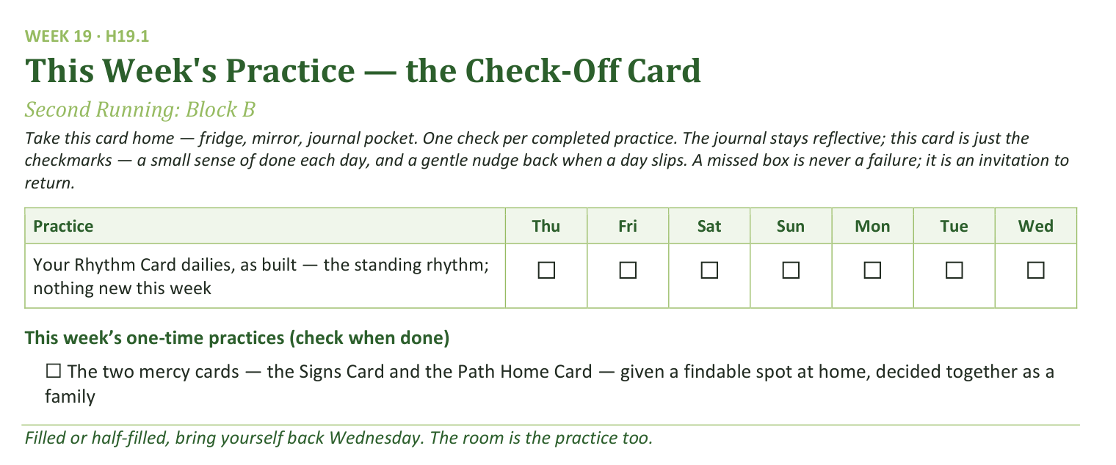
Your Take-Home Card — This Session’s Practice
Handed out now — fridge, mirror, journal pocket.
241
Notes:
S19 · 8:19–8:20 · LEAD: CONTENT PRESENTER CIRCLE
BEATS:
1. Check-off card H19.1: the Rhythm Card dailies as built — the standing rhythm, nothing new this week.
2. One one-time box: the two mercy cards given a findable spot at home, decided together as a family.
3. A missed box is never a failure; it is an invitation to return.

Slide 13
Closing the Container + Aaronic Blessing
• We close the way we opened — the container, six steps:
1 Stand again — same circle, same posture as the open
2 One-word landing — compare it to your opening word
3 The one thing you are taking from tonight
4 The one practice — committed aloud, or modified to one you will actually keep
5 Blessings — specific, witnessed, short
6 Closing prayer — and the Aaronic blessing, spoken over each other, face to face
THE AARONIC BLESSING — NUMBERS 6:24–26
“The Lord bless you and keep you;
the Lord make his face to shine upon you, and be gracious to you;
the Lord lift up his countenance upon you, and give you peace.”
242
Notes:
S19 · 8:28–8:30 · LEAD: CONTAINER HOLDER CIRCLE
BEATS:
1. A CiF runs the close, brief today: standing circle, one-word landing, the one thing, the one practice.
2. The one practice is the findable spot — committed aloud by a voice from each family.
3. Hold the Aaronic blessing — today it comes after the feedback round; a CiF speaks it at the very end.

Slide 14
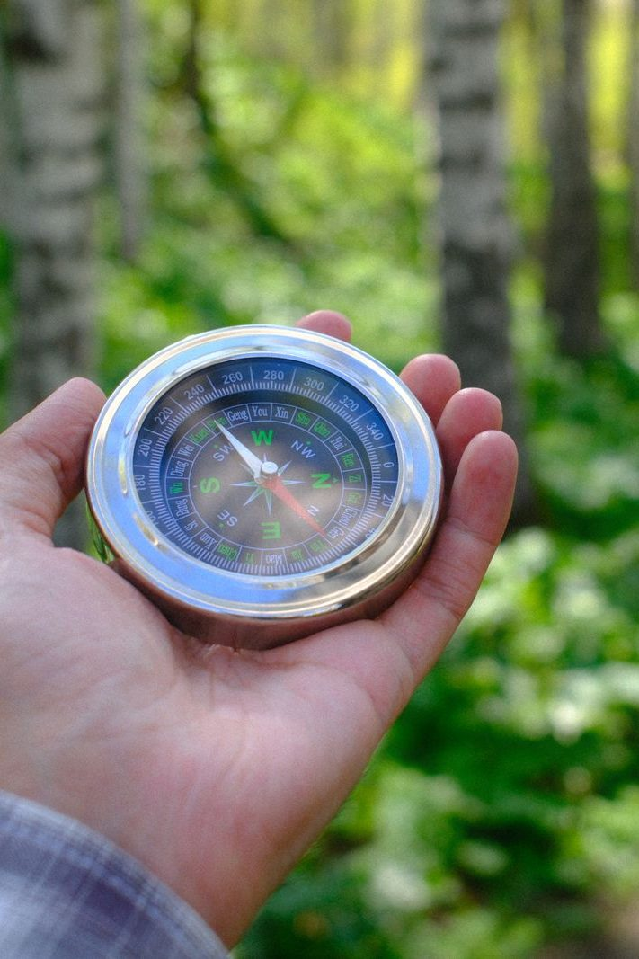
The Leader Feedback Round
• Two rounds, same as every session — the container holder first, then the content presenter: three things each
– “What I think went well tonight: ______”
– “What I’d do differently next time: ______”
– “If I were to teach tonight’s process to someone, I would tell them: ______”
• Then the room — the same two questions about tonight
• The leaders receive without defending — “thank you” is the whole response
243
Notes:
S19 · 8:24–8:28 · LEAD: BOTH LEADERS CIRCLE
BEATS:
1. The CiFs answer first, together: what went well, what they'd do differently — next week IS the next time — and one sentence on what they'd tell someone teaching this.
2. The Lead Companion answers second for the whole evening, plus one specific affirmation of the teachers AS A GROUP; individual coaching stays in the pair notes.
3. Room feedback only by the CiFs' consent — any one of them may decline for all; two or three voices, received undefended.
4. Then a CiF sends the room (5:27): Aaronic blessing, hands up — cards to their spot this week; see you at The Long Walk.

